Slide 1
Python – Variables, Data types, Operators, Control Statements

Slide 2
Understand core concept of Python
Use control structures such as loops (for and while) and conditional statements (if, elif, else) to control program flow
Understand complex data structures like lists, tuples, dictionaries, and sets
Difference between different complex data types of Python

Slide 3
Introduction to Python
Python Definition and History
Definition: Python is a high-level, interpreted, interactive and object-oriented scripting language.
History: Since its introduction by Guido van Rossum .
Python was conceived in the late 1980s by Guido van Rossum, a Dutch programmer. He started working on it as a side project in December 1989 and released the first version, Python 0.9.0, in February 1991.
The name "Python" was chosen as a tribute to the British comedy group Monty Python, whose work Guido van Rossum enjoyed.
Python 2.0 was released in 2000
Python 3.0 was released at the end of 2008. This version of Python cleaned up many of the inconsistencies in the design of the various releases of Python 2 (often referred to as Python 2.x).
It was not backward compatible. That meant that most programs written for earlier versions of Python could not be run using implementations of Python 3.0.

Slide 4
Introduction to Python
Python Features
Easy-to-learn: Python has relatively few keywords, simple structure, and a clearly defined syntax.
Easy-to-read: Python code is much more clearly defined and visible to the eyes.
Easy-to-maintain: Python's success is that its source code is easy-to-maintain.
A broad standard library: One of Python's greatest strengths is the bulk of the library is very portable and cross-platform compatible on UNIX, Windows and Macintosh.
Interactive Mode: Support for an interactive mode in which you can enter results from a terminal right to the language, allowing interactive testing and debugging of snippets of code.
Portable: Python can run on a wide variety of hardware platforms and has the same interface on all platforms.
Extendable: You can add modules to the Python interpreter. These modules enable programmers to add to or customize their tools to be more efficient.

Slide 5
Introduction to Python
Python Features
Databases: Python provides interfaces to all major commercial databases.
GUI Programming: Python supports GUI applications that can be created and ported to many system calls, libraries and windows systems, such as Windows MFC, Macintosh and the X Window system of Unix.
Scalable: Python provides a better structure and support for large programs than shell scripting.
Apart from above list, Python has a big list of other good features:
Support for functional and structured programming methods as well as OOP.
It can be used as a scripting language or can be compiled to byte-code for building large applications.
Very high-level dynamic data types and supports dynamic type checking.
Supports automatic garbage collection.
It can be easily integrated with C, C++, COM, ActiveX, CORBA and Java.

Slide 6
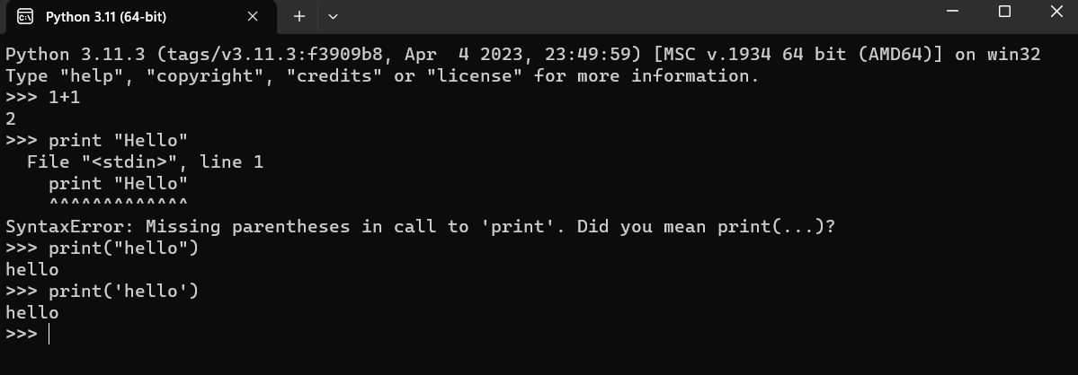
Introduction to Python
Python Shell – REPL (Read, Evaluate, Print, Loop)
Error
>>> (REPL – which waits programmer to enter something)
Note : You can also use Python IDLE or Jupyter Notebook for Python Programming

Slide 7
Introduction to Python
Python Identifiers
A Python identifier is a name used to identify a variable, function, class, module or other object.
An identifier starts with a letter A to Z or a to z or an underscore (_) followed by zero or more letters, underscores and digits (0 to 9).
Python does not allow punctuation characters such as @, $ and % within identifiers.
Python is a case sensitive programming language. Thus, Subject and subject are two different identifiers in Python.
Following are the identifier naming convention for Python:
Class names start with an uppercase letter and all other identifiers with a lowercase letter.
Starting an identifier with a single leading underscore indicates by convention that the identifier is meant to be private.
Starting an identifier with two leading underscores indicates a strongly private identifier.
If the identifier also ends with two trailing underscores, the identifier is a language-defined special name.

Slide 8
Introduction to Python
Python Reserve Words
The following list shows the reserved words in Python.
These reserved words may not be used as constant or variable or any other identifier names.
All the Python keywords contain lowercase letters only.
and | exec | not | assert | finally | or | break
for | pass | class | from | print | continue | global
raise | def | if | return | del | import | try
elif | in | while | else | is | with | except
lambda | yield

Slide 9
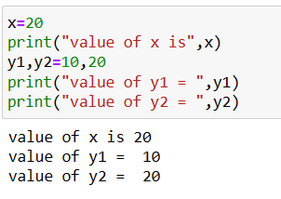
Introduction to Python
Variables and assignment statement
A variable is a name associated with an object
Suppose you want to store value somewhere and use in another place later, use variable.
These values can be anything – numbers, strings, computed results etc.
A simple assignment statement
Variable = Expression;
Python allows multiple assignments
var1, var2 = 10, 20

Slide 10
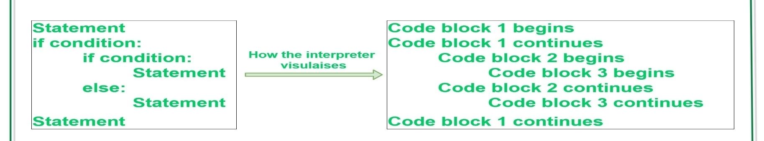
Introduction to Python
Lines and Indentation
• There are no braces ( { } ) to indicate blocks of code for class and function definitions or flow control.
Blocks of code are denoted by line indentation, which is rigidly enforced.
• The number of spaces in the indentation is variable, but all statements within the block must be
indented the same amount.

Slide 11
Introduction to Python
Multi-Line Statements
Statements in Python typically end with a new line. Python does, however, allow the use of the line continuation character (\) to denote that the line should continue. For example:
total = item_one + \
item_two + \
item_three
Statements contained within the [], {} or () brackets do not need to use the line continuation character. For example:
days = [ 'Monday', 'Tuesday', 'Wednesday', 'Thursday', 'Friday']

Slide 12
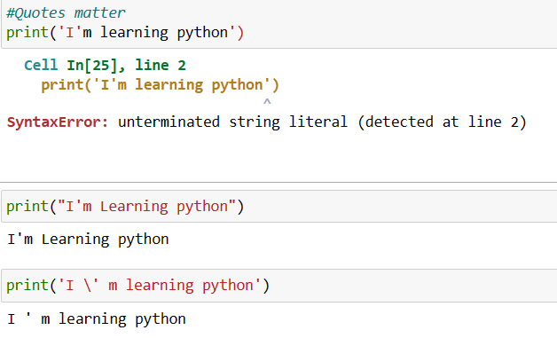
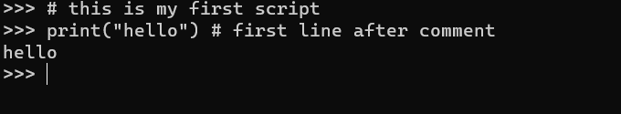
Introduction to Python
Quotation in Python
Python accepts single ('), double (") and triple (''' or """') quotes to denote string literals, as long as the same type of quote starts and ends the string.
The triple quotes can be used to span the string across multiple lines.
For example, all the following are legal:
word = 'word’
sentence = "This is a sentence."
paragraph = """This is a paragraph. It is
made up of multiple lines and sentences."""
Note : You can write comments in python using #
E.g.

Slide 13
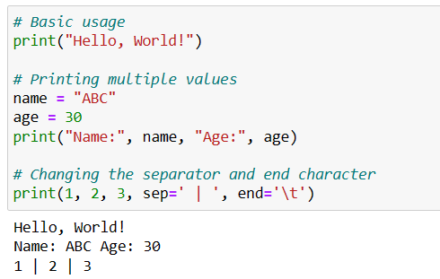
Introduction to Python
Interacting with Python Programs
print() function - In Python, the print() function is commonly used to output text and values to the console or terminal. It allows you to display information to the user, inspect the values of variables, and debug your code.

Slide 14
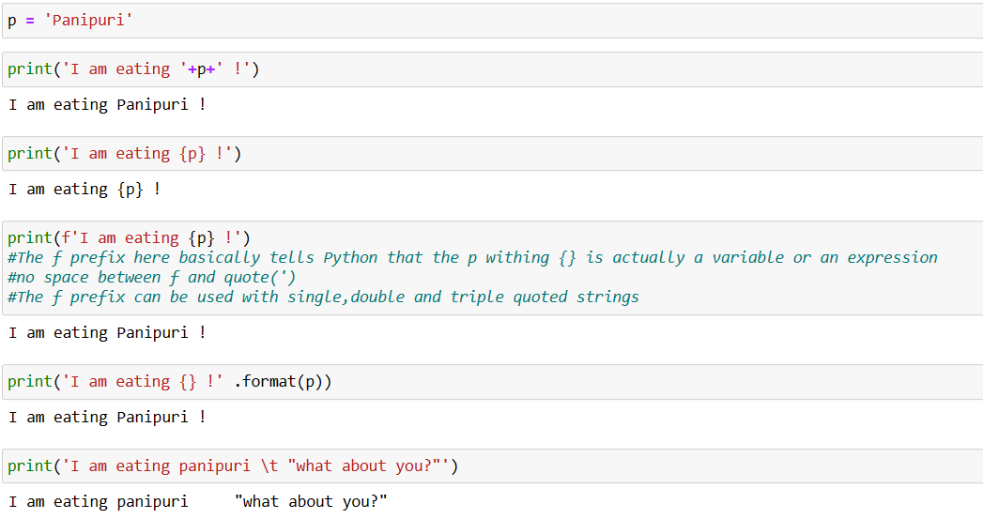
Introduction to Python
Interacting with Python Programs
print() function with different formats

Slide 15
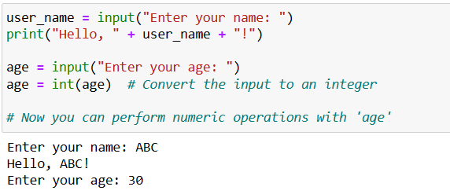
Introduction to Python
Interacting with Python Programs
input() function - In Python, the input() function is used to accept user input from the keyboard. It allows you to prompt the user for a line of text and store the user's input as a string.
Note : Python 3 uses input to read user
input as a string (str)

Slide 16
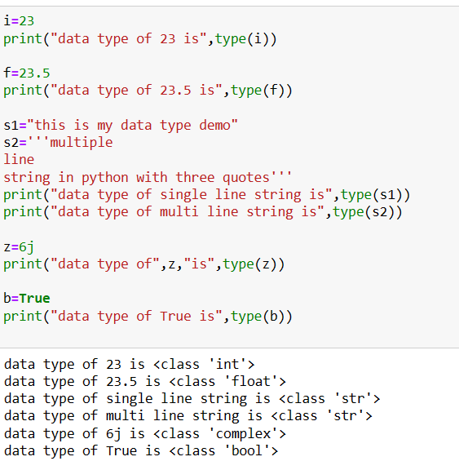
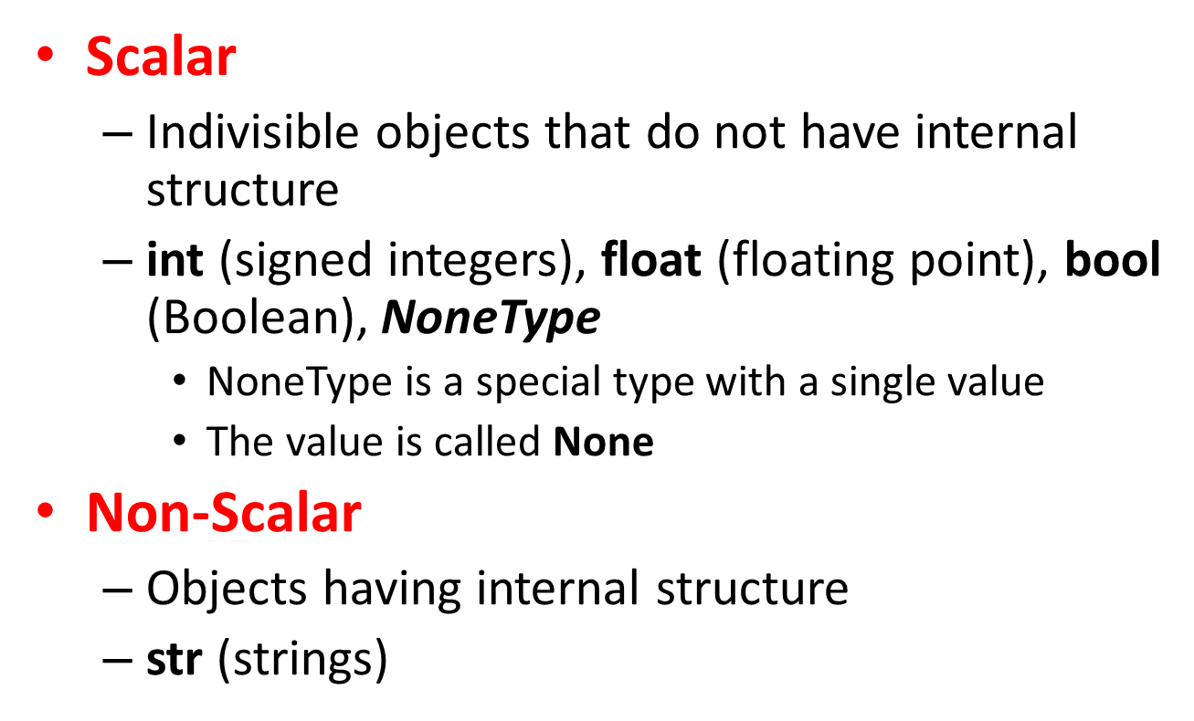
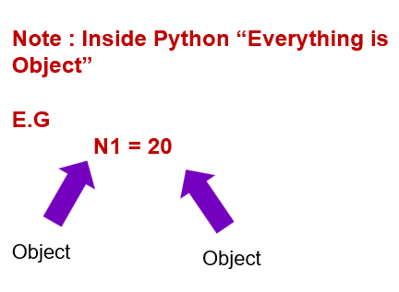
Introduction to Python
Simple Data Types in Python
Python is a dynamically-typed language, which means that variables do not have explicit data types associated with them.
Instead, the data type of a variable is determined at runtime based on the value it holds.

Slide 17
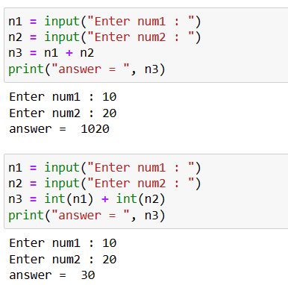
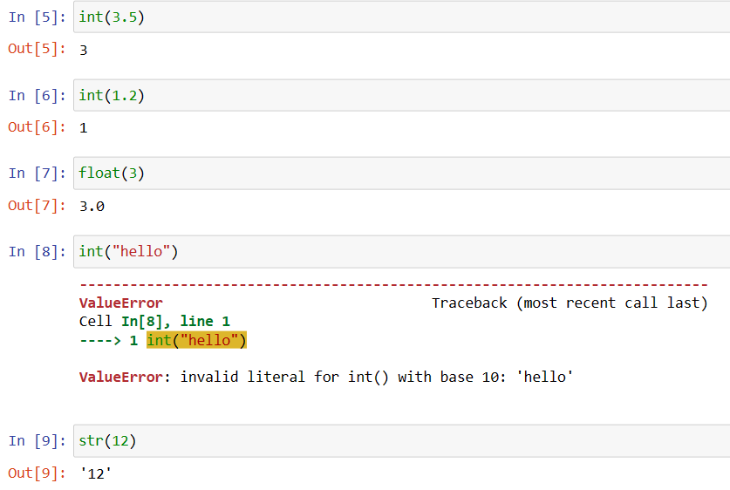
Introduction to Python
Input function and type conversion
Type casting – type conversion
Note that float to int conversion
is truncation, not rounding off

Slide 18
Introduction to Python
Order of operations : PEMDAS
Parenthesis, Exponent, Multiplication,
Division, Addition, Subtraction
Operators
Arithmetic
Comparison
Assignment
Logical
Bitwise
Membership
Identity
+ | - | * | // | / | % | **
== | != | > | < | >= | <=
= | += | -= | *= | //= | /= | %= | **=
and | or | not
& | | | ^ | ~ | >> | <<
in | not in
is | is not

Slide 19
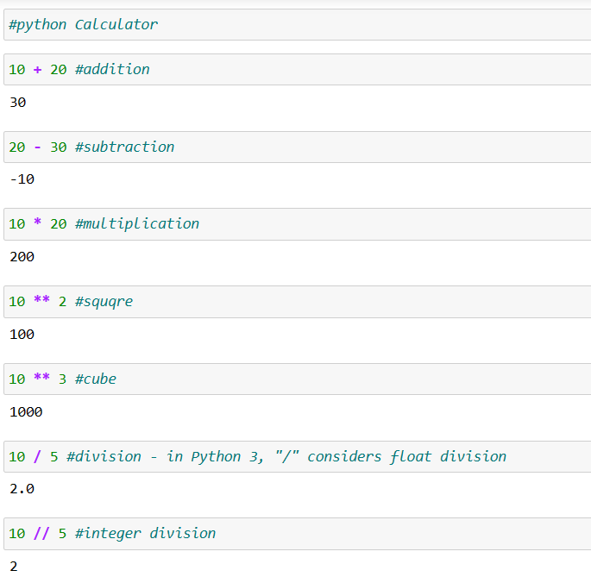
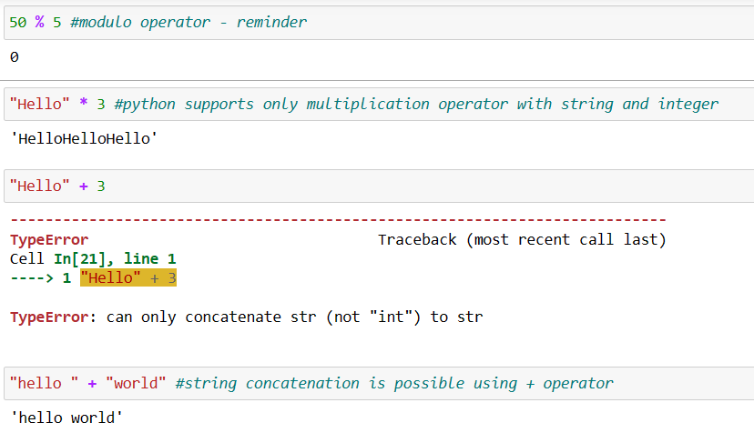
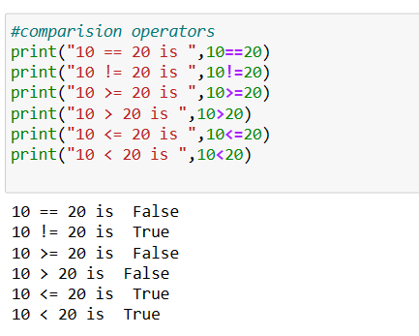

Slide 20
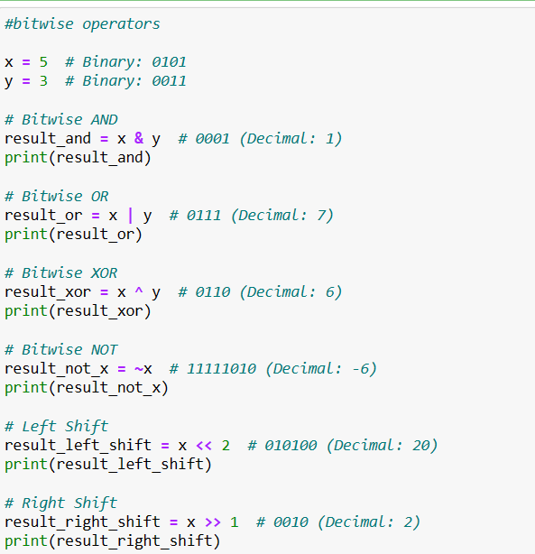
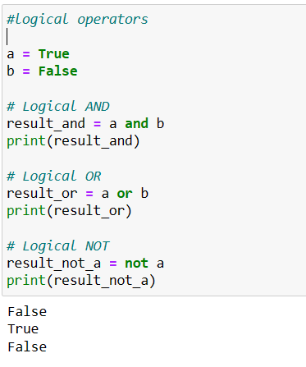
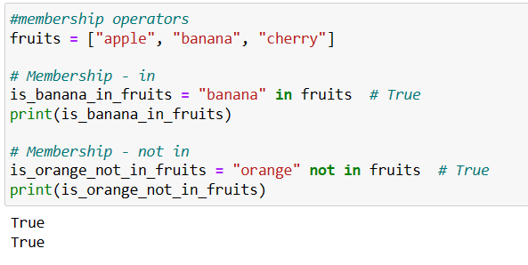
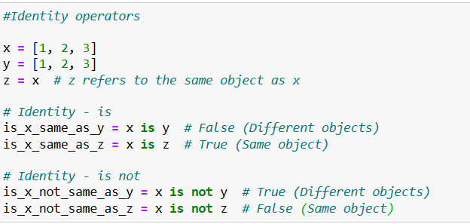

Slide 21
Knowledge Check (1 of 10)
Which of the following is an immutable data type in Python?
a) List
b) Dictionary
c) String
d) Set
Notes:
Key Message/s: Answer: Option C

Slide 22
Knowledge Check (2 of 10)
What will be the output of the following code snippet?
x = 10
y = x
y += 5
print(x, y)
a) 10 10
b) 10 15
c) 15 15
d) Error
Notes:
Key Message/s: Answer: Option B

Slide 23
Knowledge Check (3 of 10)
What will be the output of the following code?
x = 10
y = 3
print(x // y)
a) 3.33
b) 3
c) 4
D) Error
Notes:
Key Message/s: Answer: Option B: 3

Slide 24
Knowledge Check (4 of 10)
What is the datatype of the variable result in the following code?
result = 5 + 2.0
A) int
B) float
C) str
D) complex
Notes:
Key Message/s: Answer: Option B: Float

Slide 25
Knowledge Check (5 of 10)
What will be the output of the following code?
a = 5
b = "5"
print(a + int(b))
A) 55
B) 10
C) Error
D) "10"
Notes:
Key Message/s: Answer: Option B: 10

Slide 26
Knowledge Check (6 of 10)
Which of the following is NOT a valid variable name in Python?
A) my_var
B) _myVar
C) 2ndVar
D) var_2
Notes:
Key Message/s: Answer: Option C: 2ndVar

Slide 27
Knowledge Check (7 of 10)
What will be the output of the following code?
x = 10
y = 5
x += y - x * y // x
print(x)
A) 5
B) 10
C) 15
D) 9
Notes:
Key Message/s: Answer: Option B: 10

Slide 28
Knowledge Check (8 of 10)
What will be the output of the following code?
x = 3 + 4j
y = 2
result = x * y
print(type(result))
A) <class 'int'>
B) <class 'complex'>
C) <class 'float'>
D) <class 'str'>
Notes:
Key Message/s: Answer: Option B: 10

Slide 29
Knowledge Check (9 of 10)
What will be the output of the following code?
x = True
y = False
print(x + y, x * y)
A) 1 0
B) True False
C) Error
D) 2 0
Notes:
Key Message/s: Answer: Option A: 1 0

Slide 30
Knowledge Check (10 of 10)
What will be the output of the following code?
print(10 > 5 > 2)
A) True
B) False
C) Error
D) None
Notes:
Key Message/s: Answer: Option A: True

Slide 31
Conditional Statements
: Colon Must
if first condition:
first body
elif second condition:
second body
elif third condition:
third body
else:
fourth body

Slide 32
Conditional Statements
Python programming language provides following types of decision making statements.
if statements An if statement consists of a Boolean expression followed by one or more statements.
if...else statements An if statement can be followed by an optional
else statement, which executes when the boolean expression is false.
nested if statements You can use one if or else if statement inside another if or else if statement(s).
3. if-elif-else Statement:
x = 3
if x > 5:
print("x is greater than 5")
elif x == 5:
print("x is equal to 5")
else:
print("x is less than 5")
Basic if Statement:
x = 10
if x > 5:
print("x is greater than 5")
2. if-else Statement:
x = 3
if x > 5:
print("x is greater than 5")
else:
print("x is not greater than 5")

Slide 33
Conditional Statements
4. Nested if Statements:
x = 10
y = 5
if x > 5:
if y > 2:
print("Both conditions are true")
else:
print("Inner condition is false")
else:
print("Outer condition is false")
5. Short if Statements:
x = 10
if x > 5: print("x is greater than 5")

Slide 34
Looping Statements
In Python, looping statements allow you to execute a block of code repeatedly. Python provides two main types of loops: for loops and while loops. Here's an overview of each:
1. for Loop:
A for loop is used to iterate over a sequence (such as a list, tuple, string, or range) or any other iterable object.
It executes a block of code for each item in the sequence.
Syntax :
for item in sequence:
# Code to be executed for each item
Example :
fruits = ["apple", "banana", "cherry"]
for fruit in fruits:
print(fruit)

Slide 35
Looping Statements
Python provides several loop control statements
to modify the behavior of loops:
break: Terminates the loop prematurely when a certain condition
is met.
continue: Skips the rest of the current iteration and proceeds to
the next iteration of the loop.
2. while Loop:
A while loop is used to repeatedly execute a block of code as long as a specified condition is true.
Syntax :
while condition:
# Code to be executed while the condition is true
Example :
count = 1
while count <= 5:
print(count)
count += 1
numbers = [1, 2, 3, 4, 5, 6, 7, 8, 9]
for num in numbers:
if num == 5:
break # Exit the loop when num is 5
if num % 2 == 0:
continue # Skip even numbers
print(num)

Slide 36
Looping Statements
for loop with range function –
for num in range(1, 6):
print(num)
for num in range(2, 11, 2):
print(num)
o/p :
2
4
6
8
10
o/p :
1
2
3
4
5

Slide 37
Looping Statements
for loop with else block –
In Python, you can use the else block in conjunction with a for loop to specify code that should run when the loop has completed all its iterations without being interrupted by a break statement.
The else block in a for loop is executed when the loop finishes its iteration naturally (i.e., when the loop condition becomes false).
Syntax :
for variable in iterable:
# Code to execute in each iteration
else:
# Code to execute after the loop has completed all iterations (no break)
Example :
num = 7
for i in range(2, num):
if num % i == 0:
print(num, "is not prime")
break
else:
print(num, "is prime")

Slide 38
Basic of Python Programming
Understand difference between all complex data types
Use of conditional and looping statements

Slide 39
Thank You

